Slide 1


Machine Learning LAB
Week 04

Slide 2
Topics to cover
KNN
SVM
Voting Classifier
K-mean clustering

Slide 3
KNN Algorithm
Implementation of KNN

Slide 4
KNN
import matplotlib.pyplot as plt
from sklearn.datasets import load_wine
from sklearn.model_selection import train_test_split
from sklearn.neighbors import KNeighborsClassifier
from sklearn.metrics import accuracy_score

Slide 5
KNN
# Load the Wine dataset
wine = load_wine()
X, y = wine.data, wine.target
# Split the data into training and test sets
X_train, X_test, y_train, y_test = train_test_split(X, y, test_size=0.2)

Slide 6
KNN for different values
# Define the k values to test
k_values = [1, 3, 5, 7, 9]
# Train a KNN classifier for each value of k and record the accuracy scores
accuracy_scores = []
for k in k_values:
knn = KNeighborsClassifier(n_neighbors=k)
knn.fit(X_train, y_train)
accuracy = knn.score(X_test, y_test)
accuracy_scores.append(accuracy)

Slide 7
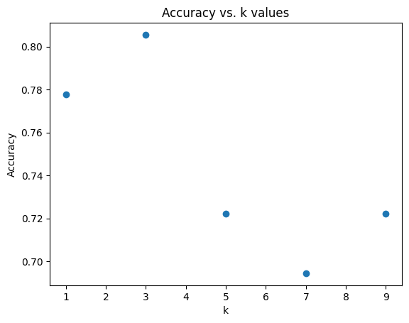
KNN for different values
# Plot accuracy against k values
plt.scatter(k_values, accuracy_scores)
plt.xlabel("k")
plt.ylabel("Accuracy")
plt.title("Accuracy vs. k values")
plt.show()

Slide 8

KNN for different values
k_values = range(1, 30)
accuracy_scores = []
# Apply KNN for different values of k
for k in k_values:
knn = KNeighborsClassifier(n_neighbors=k)
knn.fit(X_train, y_train)
y_pred = knn.predict(X_test)
accuracy = accuracy_score(y_test, y_pred)
accuracy_scores.append(accuracy)
# Print the best value of k
best_k = k_values[accuracy_scores.index(max(accuracy_scores))]
print("Best value of k:", best_k)

Slide 9
Change p values
import matplotlib.pyplot as plt
from sklearn.datasets import load_wine
from sklearn.model_selection import train_test_split
from sklearn.neighbors import KNeighborsClassifier
from sklearn.metrics import accuracy_score
# Load the Wine dataset
wine = load_wine()
X, y = wine.data, wine.target
# Split the data into training and test sets
X_train, X_test, y_train, y_test = train_test_split(X, y, test_size=0.2, random_state=42)

Slide 10
Change p values
# Define the p values to test
p_values = [1, 2, 3, 4, 5]
# Train a KNN classifier for each value of p and record the accuracy scores
accuracy_scores = []
for p in p_values:
knn = KNeighborsClassifier(n_neighbors=5, p=p) # Adjust n_neighbors as needed
knn.fit(X_train, y_train)
y_pred = knn.predict(X_test)
accuracy = accuracy_score(y_test, y_pred)
accuracy_scores.append(accuracy)

Slide 11
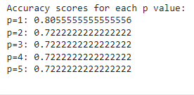
Change p values
# Print the accuracy scores for each p value
print("Accuracy scores for each p value:")
for p, accuracy in zip(p_values, accuracy_scores):
print(f"p={p}: {accuracy}")
print()

Slide 12
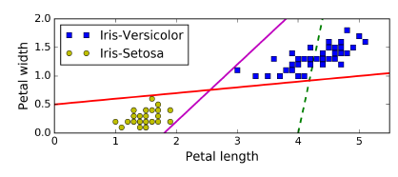
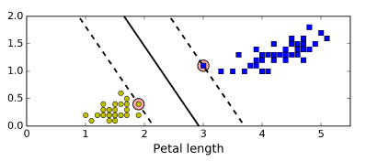
SVM
A Support Vector Machine (SVM) is a very powerful and versatile Machine Learning model, capable of performing linear or nonlinear classification, regression, and even outlier detection
You can think of an SVM classifier as fitting the widest possible street (represented by the parallel dashed lines) between the classes.
This is called large margin classification

Slide 13
SVM
Notice that adding more training instances “off the street” will not affect the decision boundary at all: it is fully determined (or “supported”) by the instances located on the
edge of the street. These instances are called the support vectors

Slide 14
SVM
# Import all relevant libraries
from sklearn.svm import SVC
import numpy as np
import pandas as pd
from sklearn.preprocessing import StandardScaler
from sklearn.model_selection import train_test_split
from sklearn.metrics import accuracy_score, confusion_matrix
from sklearn import preprocessing
from sklearn.model_selection import train_test_split, cross_val_score
import warnings
warnings.filterwarnings("ignore")

Slide 15
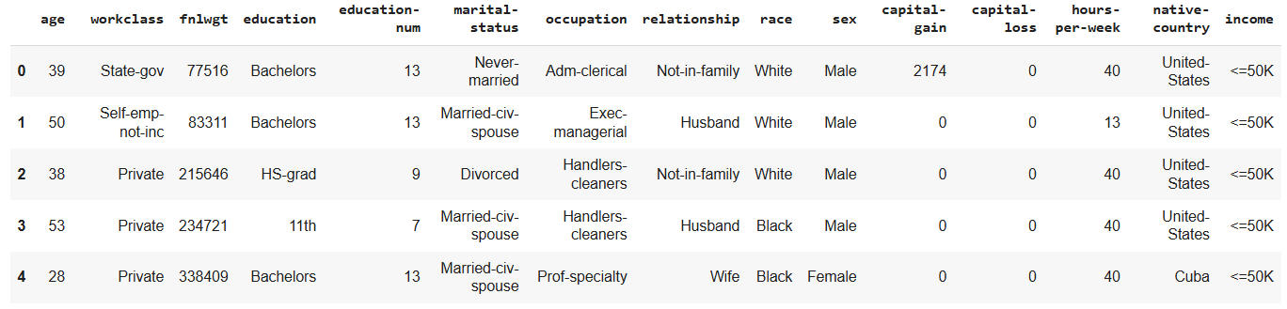
SVM
df = pd.read_csv('/content/income_evaluation.csv')
df.head()

Slide 16
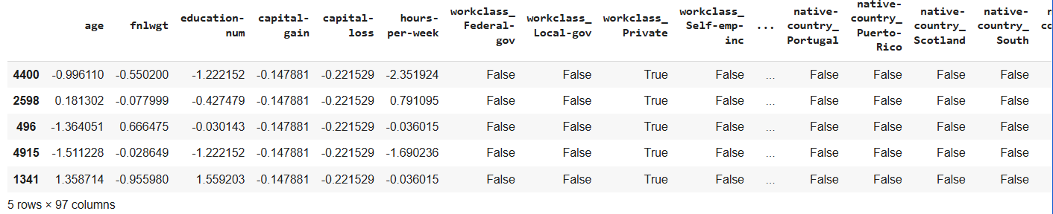
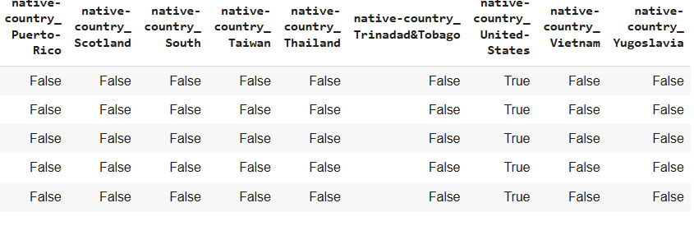
SVM
# Identify categorical and numerical features
categorical_features = df.select_dtypes(include=['object']).columns
numerical_features = df.select_dtypes(exclude=['object']).columns
# Apply one-hot encoding to categorical features
df = pd.get_dummies(df, columns=categorical_features, drop_first=True)
# Separate features and target variable again after one-hot encoding
X = df.drop("income_ >50K", axis=1) # Adjust target column name based on get_dummies output
y = df["income_ >50K"]
# Split data into training and testing sets
X_train, X_test, y_train, y_test = train_test_split(X, y, test_size=0.2, random_state=101)
# Scale numerical features
scaler = StandardScaler()
X_train[numerical_features] = scaler.fit_transform(X_train[numerical_features])
X_test[numerical_features] = scaler.transform(X_test[numerical_features])
display(X_train.head())

Slide 17

SVM
svc = SVC(random_state=101)
svc.fit(X_train,y_train)
accuracies = cross_val_score(svc,X_train,y_train,cv=5)
print("Train Score:", np.mean(accuracies))
print("Test Score:", svc.score(X_test,y_test))

Slide 18

from sklearn.model_selection import GridSearchCV
grid = {
'C':[0.01,0.1,1,10],
'kernel' : ["linear","poly","rbf","sigmoid"],
'degree' : [1,3,5,7],
'gamma' : [0.01,1]
}
svm = SVC ()
svm_cv = GridSearchCV(svm, grid, cv = 5)
svm_cv.fit(X_train,y_train)
print("Best Parameters:",svm_cv.best_params_)
print("Train Score:",svm_cv.best_score_)
print("Test Score:",svm_cv.score(X_test,y_test))
Tunning

Slide 19
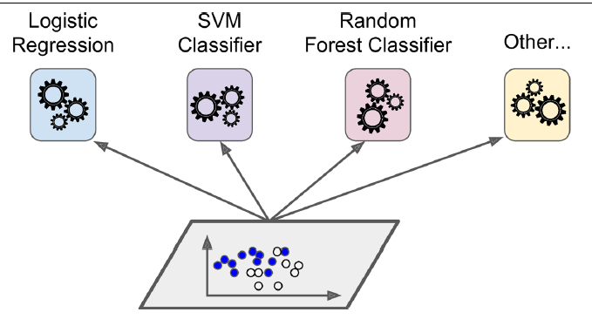
Voting Classifiers
Suppose you have trained a few classifiers, each one achieving about 80% accuracy. You may have a Logistic Regression classifier, an SVM classifier, a Random Forest classifier, a K-Nearest Neighbors classifier, and perhaps a few more

Slide 20
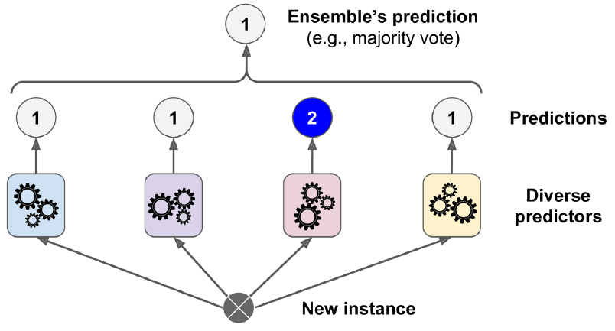
Voting Classifiers
A very simple way to create an even better classifier is to aggregate the predictions of each classifier and predict the class that gets the most votes. This majority-vote classifier is called a hard voting classifier

Slide 21
Voting Classifiers
from sklearn.ensemble import RandomForestClassifier
from sklearn.ensemble import VotingClassifier
from sklearn.linear_model import LogisticRegression
from sklearn.svm import SVC
log_clf = LogisticRegression()
rnd_clf = RandomForestClassifier()
svm_clf = SVC()
voting_clf = VotingClassifier(
estimators=[('lr', log_clf), ('rf', rnd_clf), ('svc', svm_clf)], voting='hard’ )
voting_clf.fit(X_train, y_train)
print(voting_clf.predict([some_digit]))

Slide 22

Voting Classifiers
from sklearn.metrics import accuracy_score
for clf in (log_clf, rnd_clf, svm_clf, voting_clf):
clf.fit(X_train, y_train)
y_pred = clf.predict(X_test)
print(clf.__class__.__name__, accuracy_score(y_test, y_pred))

Slide 23
K-Means Clustering
1 - Imports
2 - Loading the data
3 - Exploratory Analysis
4 - Preprocessing the data
5 - Trainin K-Means Clustering to Find Clusters
6 - Evaluating K-Means Clustering

Slide 24
IMPORTS AND DATA LOADING
import pandas as pd
from sklearn.preprocessing import LabelEncoder
from sklearn.cluster import KMeans
from sklearn.decomposition import PCA
import matplotlib.pyplot as plt
# Step 1: Load the dataset
data = pd.read_csv("/content/mushroomss.csv")
# Display first few rows
print("Dataset Preview:")
print(data.head())
# Step 2: Check for missing values
print("\nMissing Values in Each Column:")
print(data.isnull().sum())

Slide 25
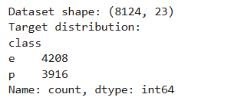
EXPLORATORY DATA ANALYSIS
print(f"Dataset shape: {mushroom_data.shape}")
print(f"Target
distribution:\n{mushroom_data['class'].value_counts()}")

Slide 26
EXPLORATORY DATA ANALYSIS
plt.figure(figsize=(15, 10))
plt.subplot(2, 3, 1)
sns.countplot(data=mushroom_data, x='class')
plt.title('Target Distribution')
plt.subplot(2, 3, 2)
sns.countplot(data=mushroom_data, x='cap-shape', hue='class')
plt.title('Cap Shape vs Class’)
plt.subplot(2, 3, 3)
sns.countplot(data=mushroom_data, x='cap-color', hue='class')
plt.title('Cap Color vs Class')

Slide 27
EXPLORATORY DATA ANALYSIS
plt.subplot(2, 3, 4)
sns.countplot(data=mushroom_data, x='population’)
plt.title('Population Distribution')
plt.subplot(2, 3, 5)
sns.countplot(data=mushroom_data, x='habitat’)
plt.title('Habitat Distribution')
plt.subplot(2, 3, 6)
sns.countplot(data=mushroom_data, x='odor', hue='class’)
plt.title('Odor vs Class')
plt.tight_layout()
plt.show()

Slide 28
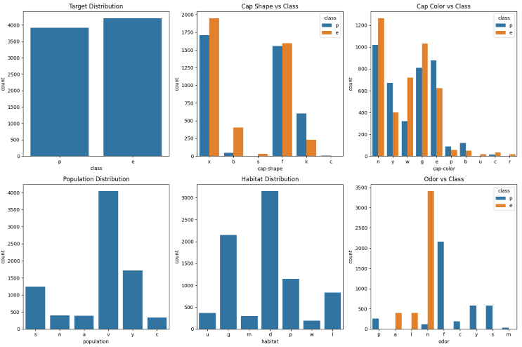
EXPLORATORY DATA ANALYSIS

Slide 29
DATA PREPROCESSING
# Handle missing values
mushroom_df = mushroom_data.dropna()
# Separate features and target
mushroom_features = mushroom_df.drop('class', axis=1)
mushroom_labels = mushroom_df['class']
# Encode categorical features
encoder = OrdinalEncoder()
mushroom_prepared =
encoder.fit_transform(mushroom_features)
mushroom_prep_df = pd.DataFrame(mushroom_prepared,
columns=mushroom_features.columns)

Slide 30
MODEL IMPLEMENTATION
KMEANS CLUSTERING
# Create and fit KMeans model
k_clust = KMeans(n_clusters=2, random_state=42)
k_clust.fit(mushroom_prep_df)
# Get results
k_labels = k_clust.labels_

Slide 31
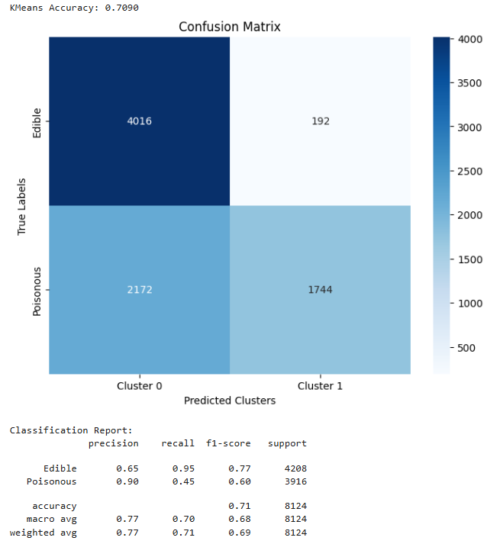
MODEL EVALUATION
# Map true labels to numerical values
map_dict = {'e': 0, 'p': 1}
true_labels = mushroom_labels.map(map_dict)
# Calculate accuracy
accuracy = accuracy_score(true_labels, k_labels)
print(f"KMeans Accuracy: {accuracy:.4f}")

Slide 32
Preprocessing Pipeline
Confusion matrix
plt.figure(figsize=(8, 6))
cm = confusion_matrix(true_labels, k_labels)
sns.heatmap(cm, annot=True, fmt='d', cmap='Blues’,
xticklabels=['Cluster 0', 'Cluster 1’],
yticklabels=['Edible', 'Poisonous’])
plt.title('Confusion Matrix')
plt.xlabel('Predicted Clusters')
plt.ylabel('True Labels')
plt.show()
# Classification report
print("\nClassification Report:")
print(classification_report(true_labels, k_labels, target_names=['Edible', 'Poisonous']))

Slide 33
UNSUPERVISED LEARNING
import pandas as pd
from sklearn.preprocessing import LabelEncoder
from sklearn.cluster import KMeans
from sklearn.decomposition import PCA
import matplotlib.pyplot as plt
# Step 1: Load the dataset
data = pd.read_csv("/content/mushroomss.csv")
# Display first few rows
print("Dataset Preview:")
print(data.head())
# Step 2: Check for missing values
print("\nMissing Values in Each Column:")
print(data.isnull().sum())
# Step 3: Encode categorical features (if any)
label_encoders = {}
for column in data.columns:
if data[column].dtype == 'object':
le = LabelEncoder()
data[column] = le.fit_transform(data[column])
label_encoders[column] = le

Slide 34
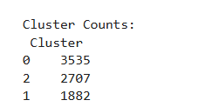
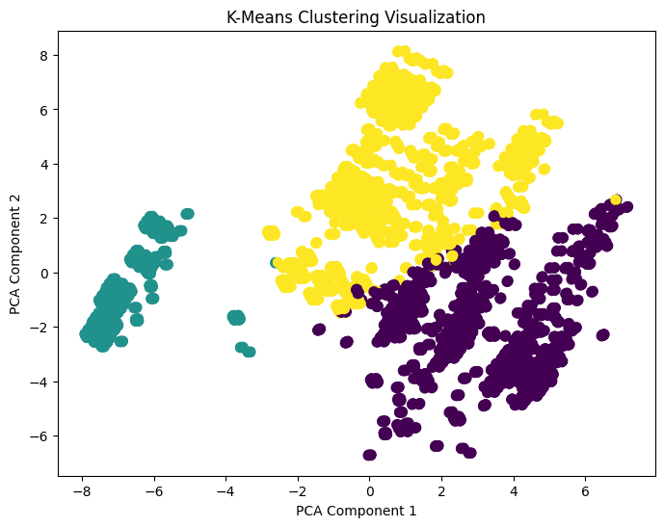
UNSUPERVISED LEARNING
# Step 4: Apply K-Means Clustering
kmeans = KMeans(n_clusters=3, random_state=42)
data['Cluster'] = kmeans.fit_predict(data)
# Step 5: Display cluster centers and counts
print("\nCluster Centers:\n", kmeans.cluster_centers_)
print("\nCluster Counts:\n", data['Cluster'].value_counts())
# Step 6: Visualize clusters using PCA (2D)
pca = PCA(n_components=2)
reduced_data = pca.fit_transform(data.drop('Cluster', axis=1))
plt.figure(figsize=(8,6))
plt.scatter(reduced_data[:,0], reduced_data[:,1], c=data['Cluster'], cmap='viridis', s=50)
plt.title('K-Means Clustering Visualization')
plt.xlabel('PCA Component 1')
plt.ylabel('PCA Component 2')
plt.show()

Slide 35
Activity 1
KNN for Credit Card Fraud Detection
Data Set: https://www.kaggle.com/datasets/mlg-ulb/creditcardfraud?resource=download
Use KNN to detect fraudulent transactions in a highly imbalanced dataset, where frauds make up less than 0.2% of all samples.
Load the dataset and split it into features X and target y.
Apply SMOTE (Synthetic Minority Oversampling Technique) or ADASYN to handle class imbalance.
Scale features using StandardScaler.
Train a KNN classifier with k=5, then tune k using GridSearchCV for best results.
Compare model performance using:
  Accuracy
  F1-Score

Slide 36
Activity 2
SVM for Brain Tumor Detection
Data Set: https://www.kaggle.com/datasets/navoneel/brain-mri-images-for-brain-tumor-detection
Load the dataset and preprocess all MRI images:
Convert to grayscale
Resize to 64×64
Flatten each image
Split data into training and testing sets (80:20).
Normalize features using StandardScaler().
Train an SVM (RBF kernel) with C=10 and gamma='scale'.
Evaluate performance using accuracy, classification report, and confusion matrix.
Display a few test images with predicted and actual labels.

Slide 37
Activity 3
Dataset:
Mall_Customers
Tasks:
Load the dataset and display it.
Apply K Mean & DBSCAN Algorithm and plot clusters using Annual Income vs Spending Score.
Scale features using StandardScaler and re-run K-Means.
Compare both results did scaling change clusters?
Use the Elbow Method to find the best k.
Briefly interpret each cluster.
Also:
Add a fake feature "LuckyNumber" (random 0–100) and explain its effect on clustering.

